Slide 1
Case Study 4
Blight Ticket Compliance
- Parth Patel
- Uday Kumbhar
- Gauri Jare
- Shrinivas Sanglikar

Slide 2
The problem
Company
Context
Problem statement
Our business idea is to convince our manager that our data insights can help Detroit Government to tackle the blight ticket issues.
Property blight affects more than 20% of properties in Detroit which makes the area unsafe. It leads to increase in non-compliance issues in public and increases work load on the governing bodies
Find the reasons for blight ticket that were issued so that the governing body can solve them.

Slide 3
When is a blight ticket issued?
Blight violation is a violation of a local ordinance, similar to a public nuisance. The precise definition varies by local area, but examples may include change in land use without a permit, lack of exterior property maintenance, or trash accumulation.

Slide 4
Why do you believe the idea deserves the financial resources of your company?
Property blight affects more than 20% of properties in Detroit, which is an astonishing statistic.
There is about 55 million$ revenue to be collected from Blight tickets.

Slide 5
Business Questions
Is the violator responsible for the blight ticket or not. And if responsible whether they’ll pay the fine for the ticket or not?
Which violators are not complying with the ticket issued?
Which Inspector is carrying out his duty of issuing tickets correctly and which aren't?
When are the most and least tickets being issued? Is there any pattern in issuing the ticket with respect to time?

Slide 6
Dataset
Fine_amount
Fees: admin_fee, state_fee, late_fee
Discount_amount
Clean up cost
judgment_amount
grafitti_status
payment_amount - Amount paid, if any
payment_date
Ticket id
Agency name
Inspector name
Violator name, violator mailing address
Violation address
Ticket issued date and time
Hearing date
Violation code and description
Judgment and judgement type
Payment status
Balance due
Collection status
Target Variable : compliance
Null = Not responsible
0 = Responsible, non-compliant
1 = Responsible, compliant

Slide 7
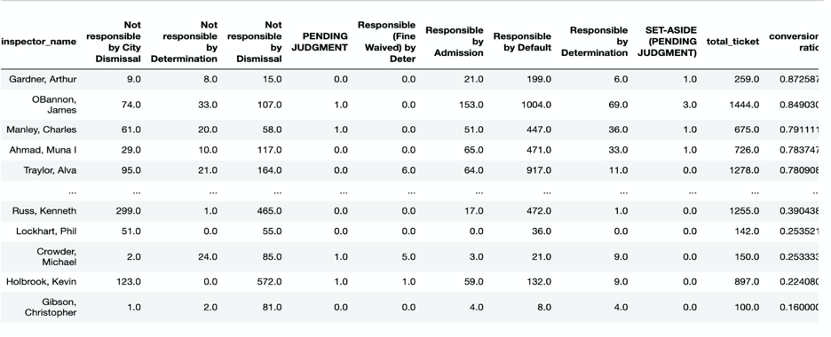
Which Inspector has the highest percent of correct ticket issuance rate?

Slide 8
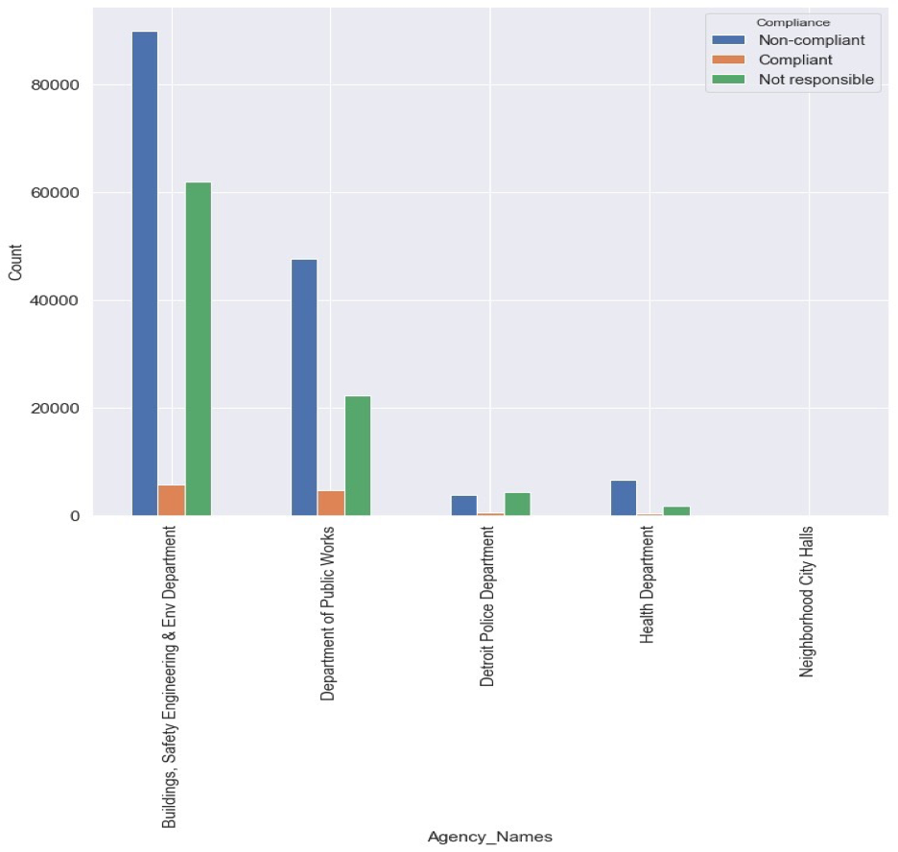
Compliance status as per department.

Slide 9
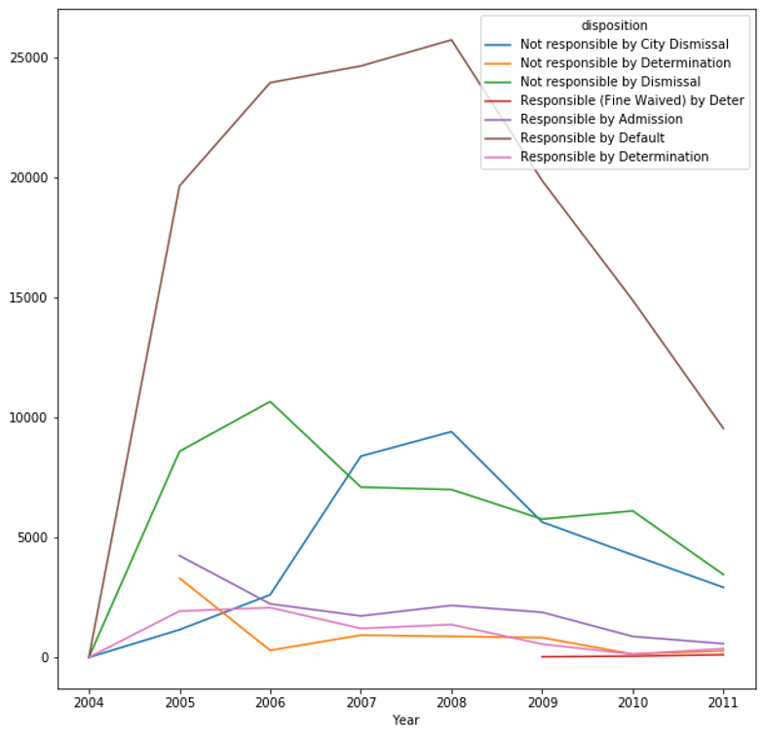
Disposition result for each year
• We analyzed various dispositions and found out that the ‘Responsible by Default’ disposition count dropped significantly after 2008.

Slide 10
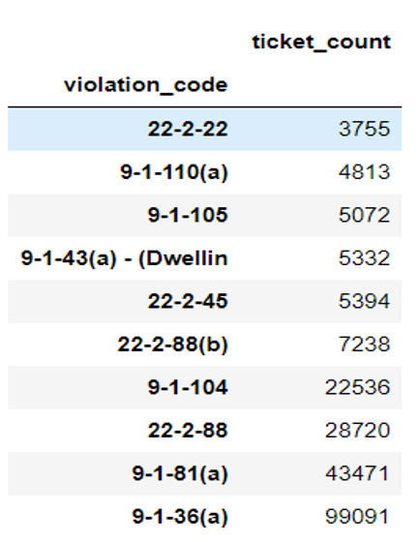
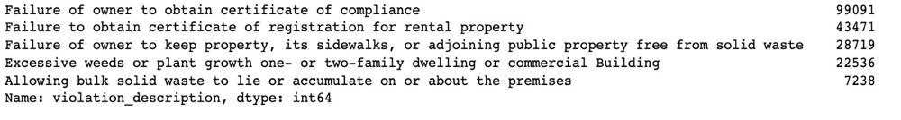
Which are the most common reason for ticket issuance?

Slide 11
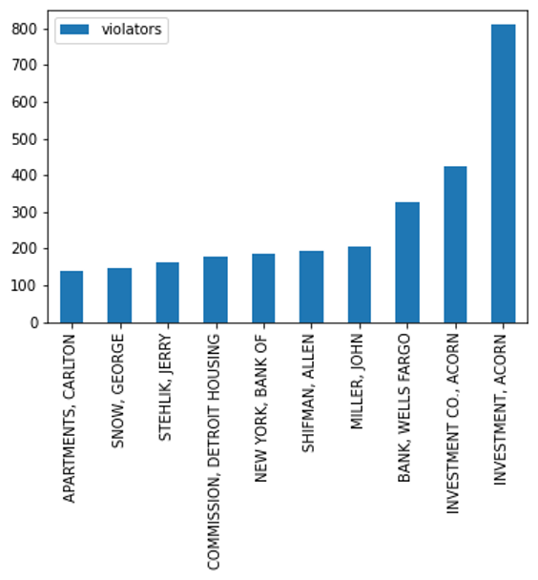
Who violates the most?
As seen, companies like Acorn Investment and Wells Fargo are being issued the most tickets

Slide 12
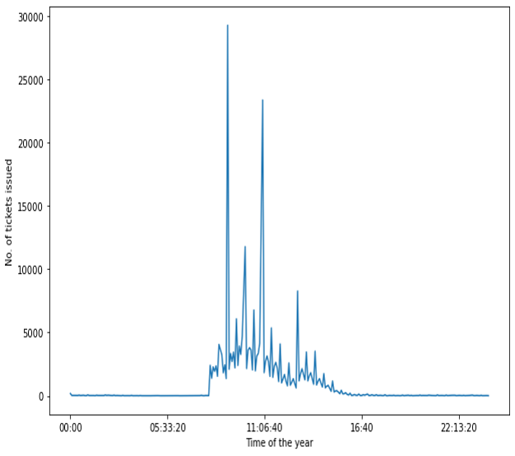
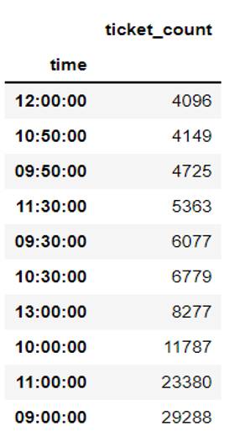
Tickets issued as per time of day

Slide 13
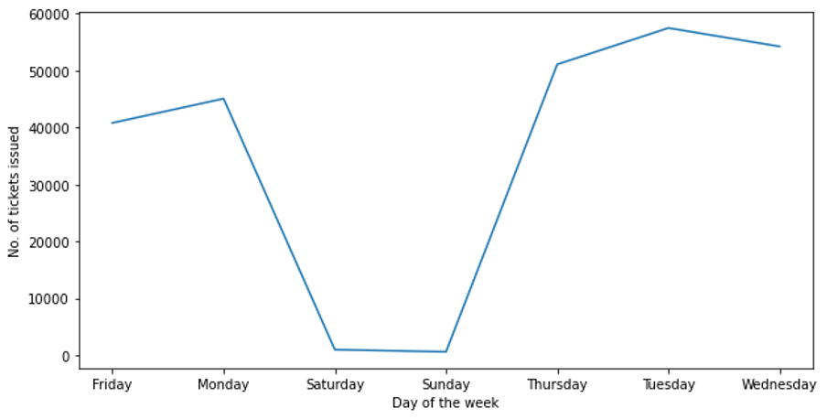
Ticket issue count as per days of the week
We find out that during weekends (i.e. Saturdays and Sundays) the tickets issued drops significantly.

Slide 14
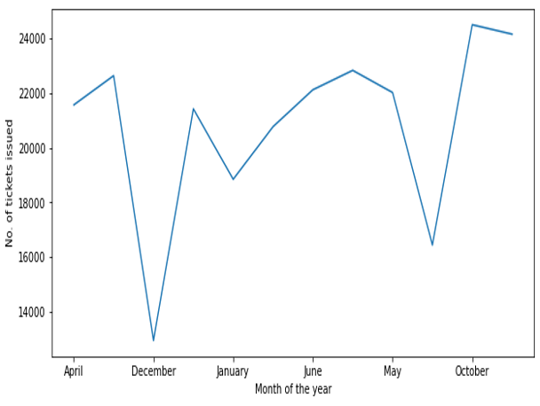
Tickets issued as per Month
We find out that during vacation and holiday season the tickets issued drops drastically

Slide 15
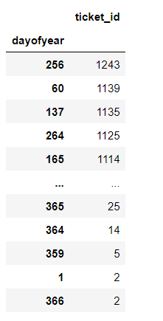
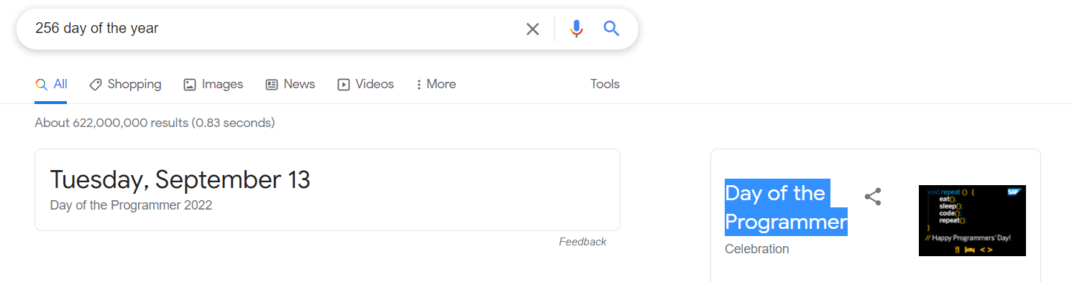
Most tickets issued were done on 256th day of the year

Slide 16
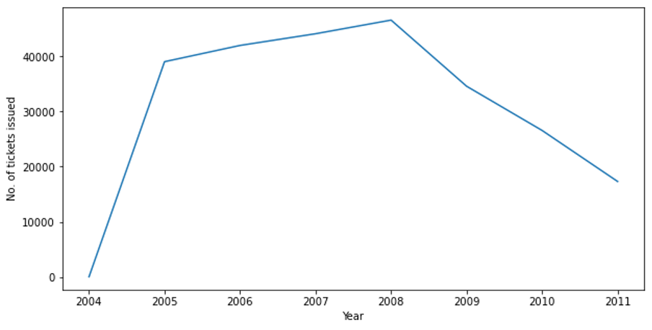
No of ticket issued year wise
We see a sharp rise to about 40000 from 2004 onwards for the ticket issued and after 2008 it steadily falls to about 20000 tickets.

Slide 17
Model

Slide 18
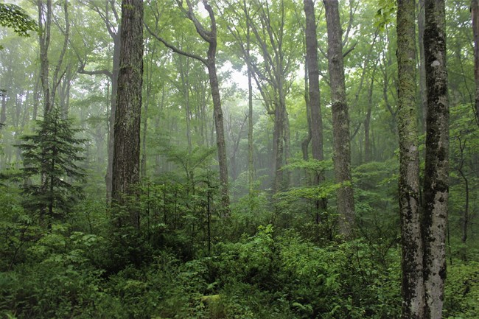
So where do Data Scientist go camping?
Random Forest

Slide 19
Random Forest
We build a model, where it identifies if the given person is responsible or not responsible for the ticket raised.
Upon being responsible it further classifies that if the violators is compliant or non compliant
We were able to achieve accuracy of 95% on model. Which means on given new data our model will accurately identify if the person is compliant or non compliant.

Slide 20
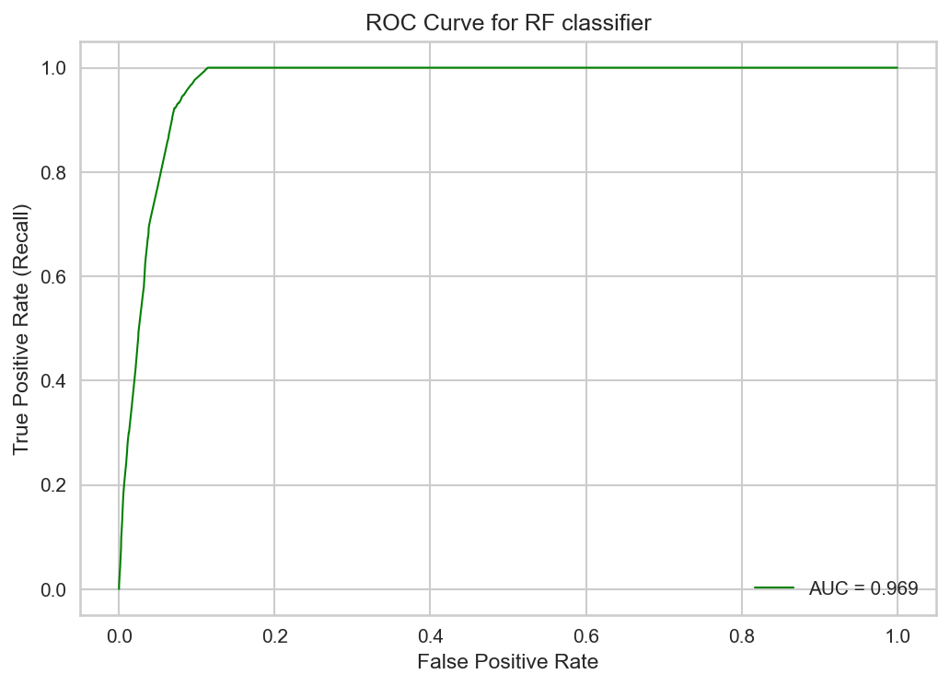
ROC & AUC
The better the model predicts 0 courses as 0 and 1 classes as 1, the higher the AUC.
AUC score 0.969 suggests that, our model is able to distinguish between classes very sufficiently.

Slide 21
CONCLUSION
It took us about 2 weeks to complete the project. We first went through bunch of open source datasets and ultimately everyone agreed to continue with this dataset as it
proposed a unique challenge and not much work was done on this topic.
We then proceeded with understanding the dataset. We then did some cleaning on it
and removed unrelated features to our project.
We then continued with Exploratory Data Analysis and came up with conjectures while
doing it. Since we were going to perform classification, we decided to go with Random
Forest Classifier. Finally, we achieved an accuracy of 95%.

